Slide 1

Cloud Computing and Information Security
PowerPoint Presentation in
Second year B. Tech Information and Cybersecurity

Slide 2

Group Members
20. Krishnaraj Thadesar (Presentation and Attacks)
15. Parth Zarekar (Cloud Computing Fundamentals)
09. Naman Soni (Best Practices)

Slide 3

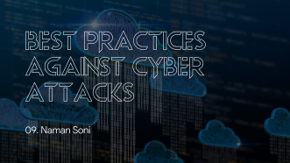
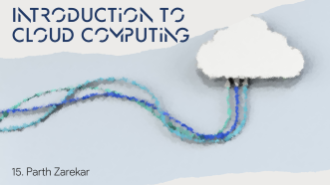

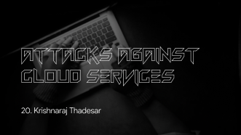
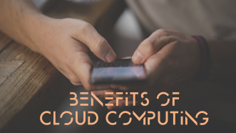
Contents

Slide 4
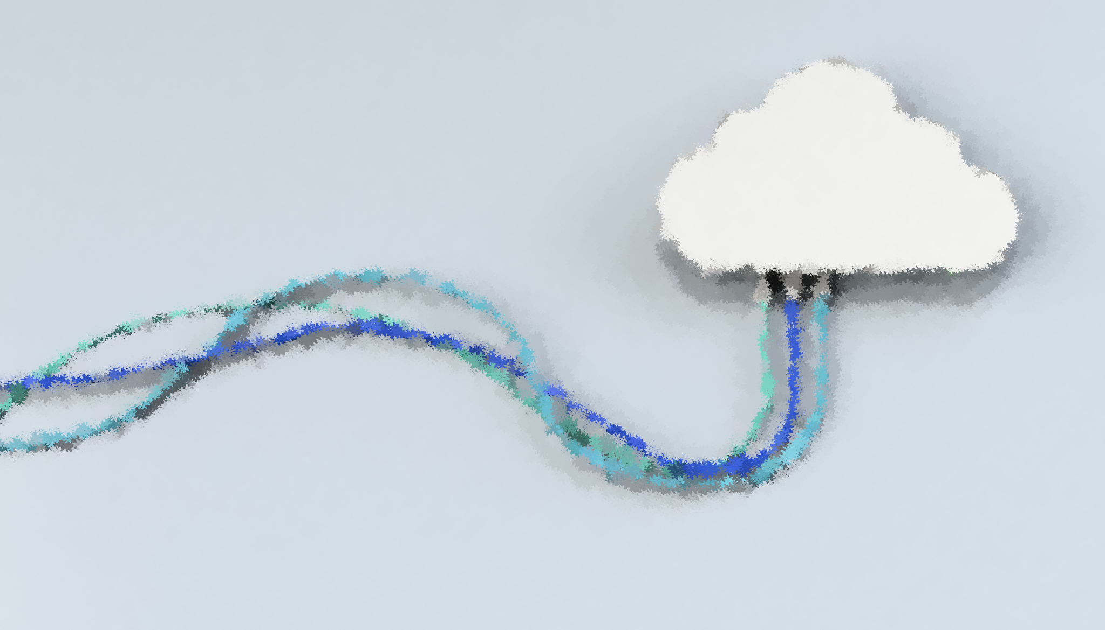
Introduction to Cloud Computing
15. Parth Zarekar

Slide 5

What is Cloud Computing
Cloud Computing is defined as storing and accessing of data and computing services over the internet. It doesn’t store any data on your personal computer.
It is the on-demand availability of computer services like servers, data storage, networking, databases, etc. The main purpose of cloud computing is to give access to data centers to many users. Users can also access data from a remote server.

Slide 6

Available Cloud Services on the Market

Slide 7
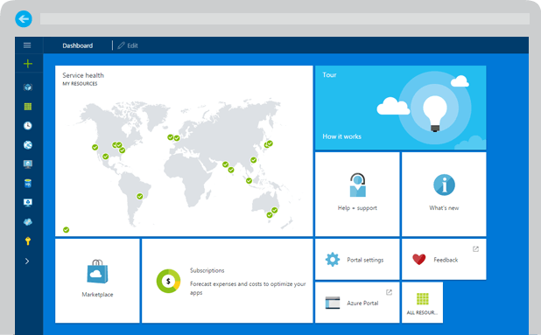
Microsoft Azure

Slide 8
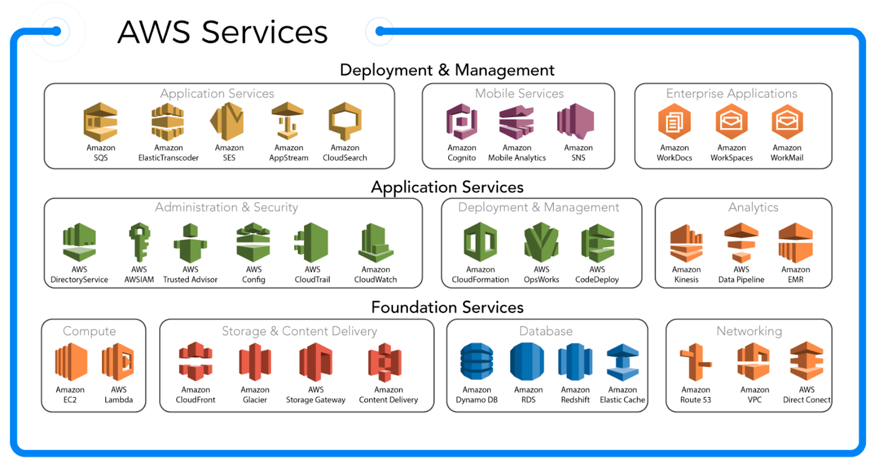
2. Amazon Web Services (AWS)

Slide 9
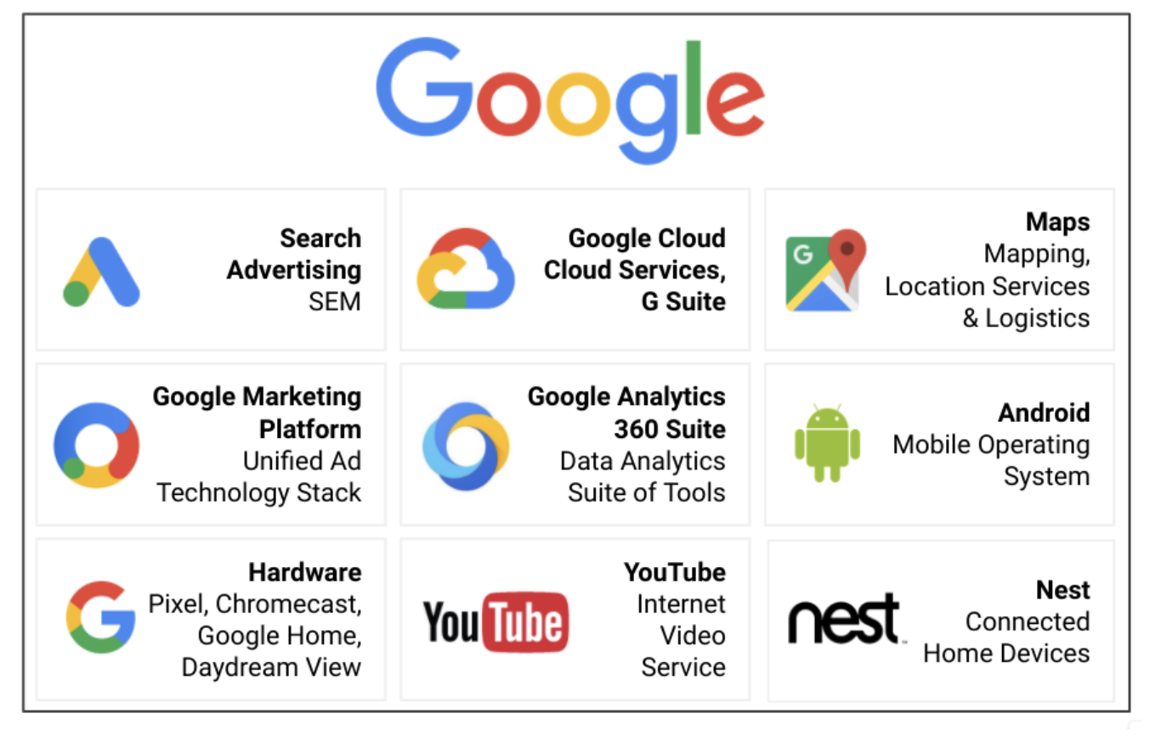
3. Google Cloud

Slide 10

Need for Cloud Services

Slide 11

We used to spend a significant Amount on Maintenance and Setup

Slide 12

2. We were limited to just the Head Office

Slide 13

3. VERY hard to Upgrade a ROOM of data servers

Slide 14

4. We had to Share Files by Email, and other FAR LESS SECURE methods

Slide 15

Benefits of Cloud Computing

Slide 16

1. Scalability

Slide 17
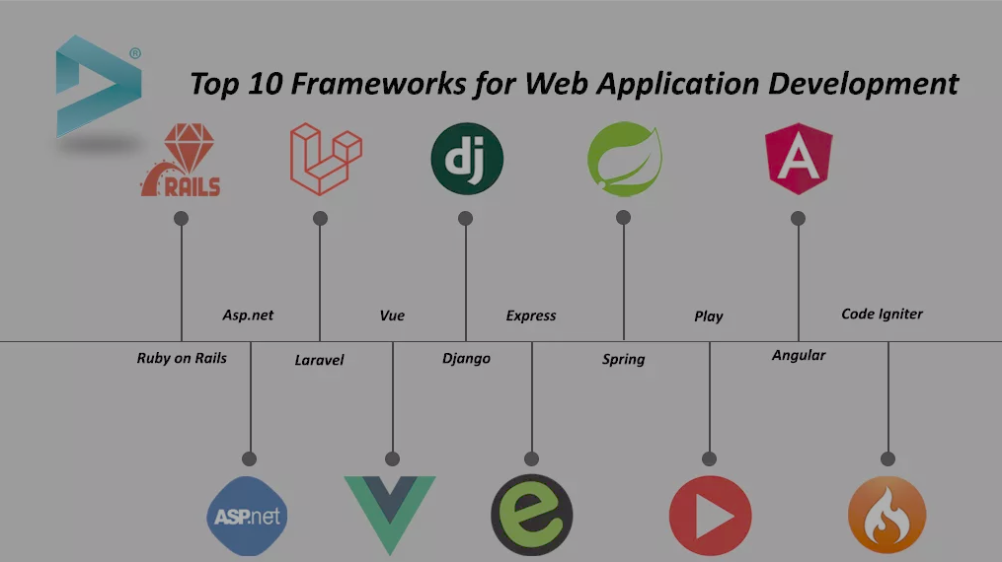
2. Agility

Slide 18

3. Elasticity

Slide 19

4. Cost Savings!

Slide 20

5. Security

Slide 21

Attacks Against Cloud Services
20. Krishnaraj Thadesar

Slide 22

Types of Attacks

Slide 23
Data Breaches
This type of attack involves stealing or accessing sensitive data such as credit card information, intellectual property, or personal information that is stored on the cloud.
The attacker may exploit vulnerabilities in the cloud service provider's infrastructure, applications, or user accounts to gain access to the data.

Slide 24
Denial-of-Service (DoS) Attacks
A DoS attack is launched to disrupt or overwhelm the cloud service provider's infrastructure, making it unavailable to users. This is achieved by flooding the provider's servers or network with excessive traffic or requests, causing a slowdown or complete outage.
a, modify configurations, or launch other types of attacks. This type of attack can be particularly damaging as the attacker already has access to the system and may know its vulnerabilities.

Slide 25
Malware Injection
In this attack, the attacker exploits a vulnerability in the cloud infrastructure or applications to inject malware that can compromise the security of the entire system. This malware can then be used to steal data or launch further attacks.

Slide 26
Man-in-the-Middle (MitM) Attacks
A MitM attack involves intercepting the communication between two parties, such as the cloud service provider and the user, to steal data or manipulate the information being exchanged.
The attacker can eavesdrop on the communication or modify it to their advantage.

Slide 27
Phishing Attacks
In a phishing attack, the attacker sends fraudulent emails or messages to cloud users, posing as a legitimate source such as the cloud service provider.
The goal is to trick users into providing their login credentials, which can then be used to access sensitive data or launch further attacks.

Slide 28
Insider Attacks
An insider attack is carried out by someone who has authorized access to the cloud infrastructure, such as an employee or a contractor. The attacker may abuse their privileges to steal data

Slide 29

CasE Studies

Slide 30
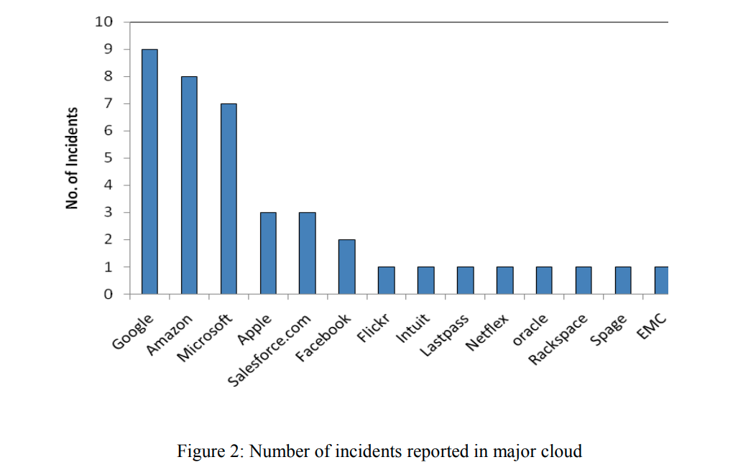
Number of incidents reported in major cloud

Slide 31
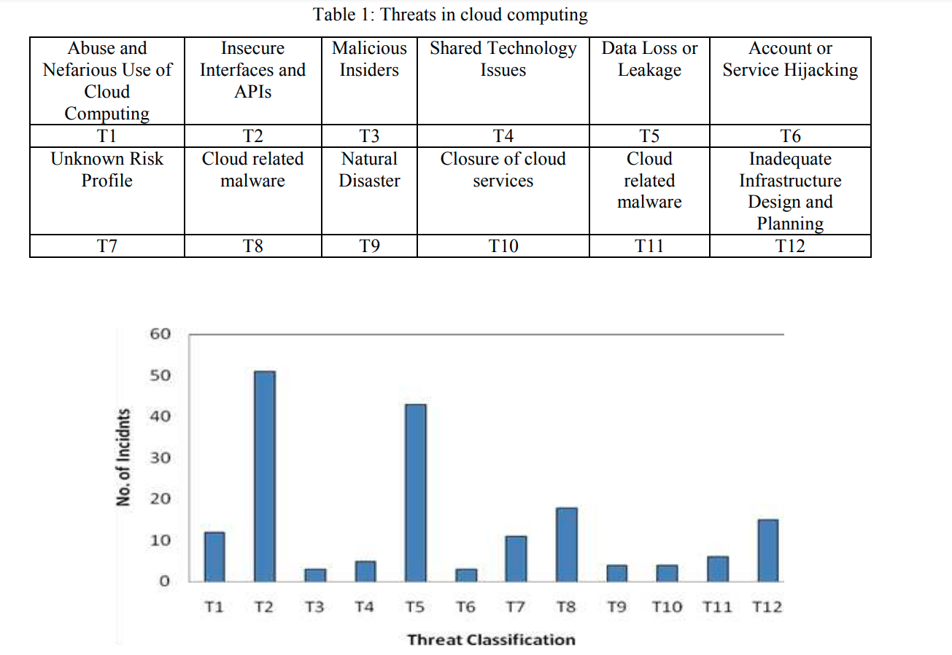
Study done by AlertLogic on “Targeted attacks and opportunistic hacks shows :

Slide 32
Facebook
Facebook was breached sometime before August 2019 but decided not to notify over 530 million of its users that their personal data was stolen

Slide 33
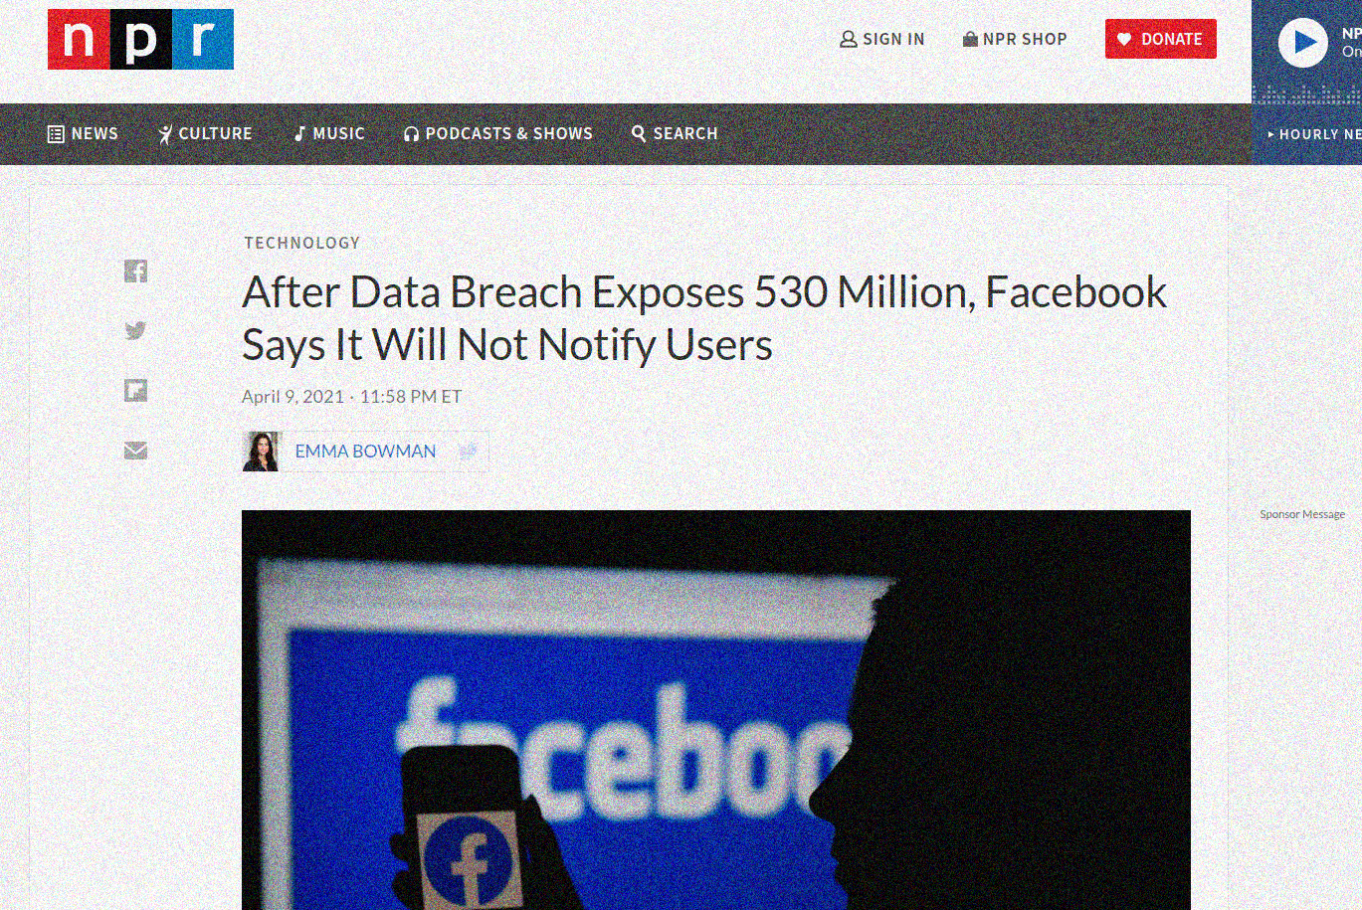

Slide 34
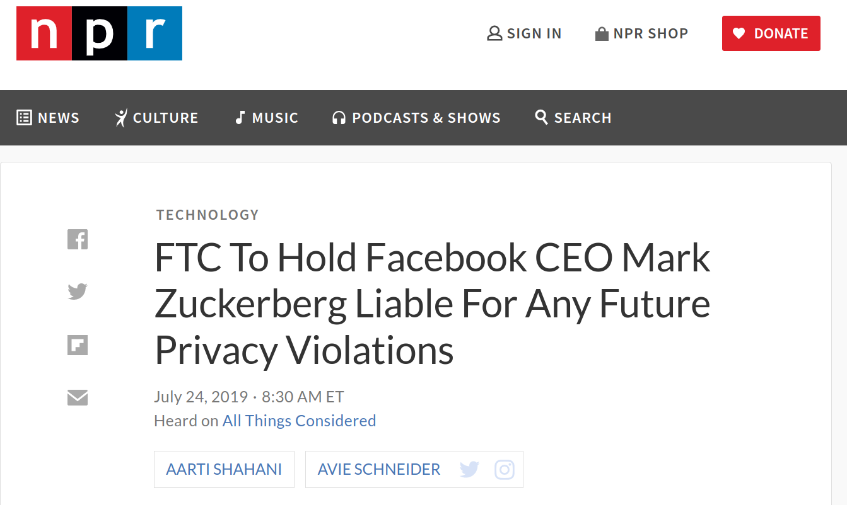

Slide 35
Alibaba
In November of 2019, an attack hit Alibaba's Chinese shopping website Taobao that impacted more than 1.1 billion pieces of user data.

Slide 36
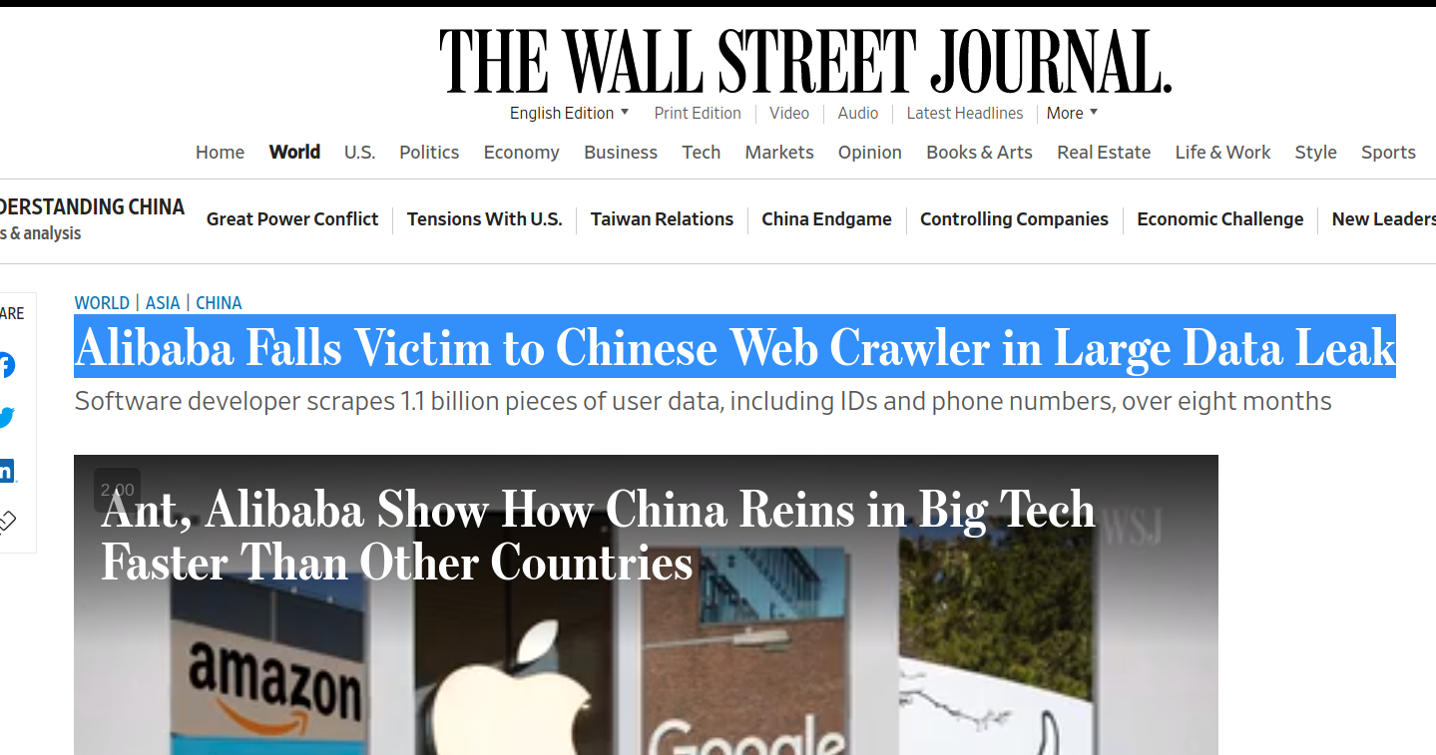

Slide 37
Linked In
Like Alibaba, in 2021, LinkedIn also fell victim to a data scraping breach. Affecting 700 million LinkedIn profiles, the information was primarily public.

Slide 38
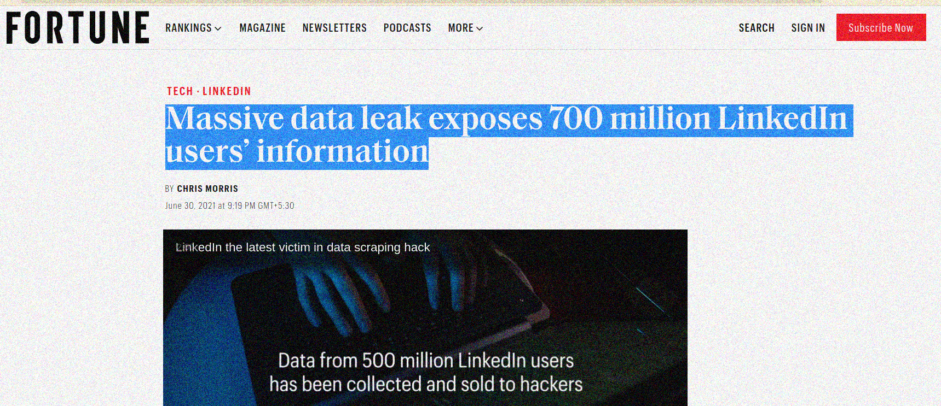

Slide 39

Best Practices Against Cyber Attacks
09. Naman Soni

Slide 40

General Safety TECHNIQUES

Slide 41
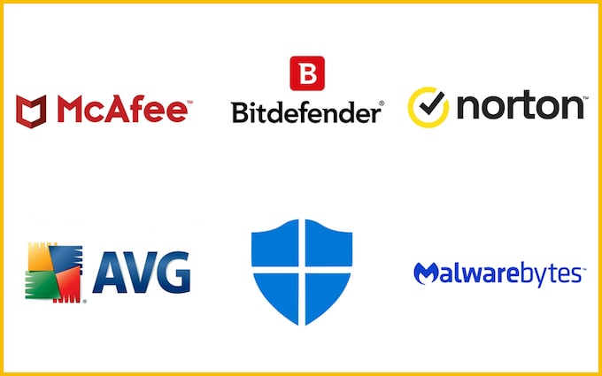
Antivirus Services

Slide 42
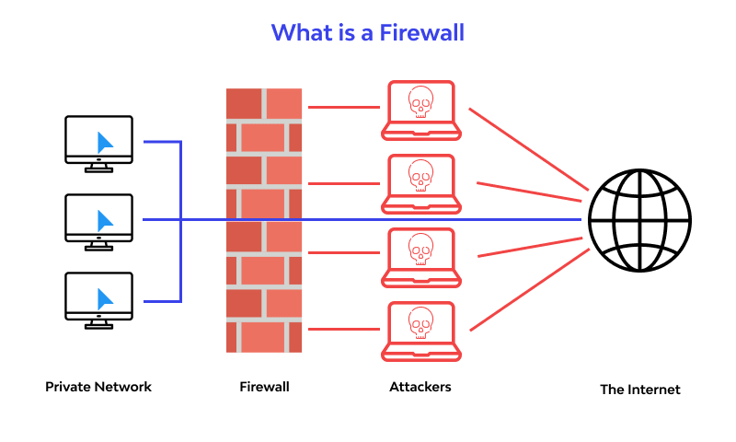
Firewalls

Slide 43
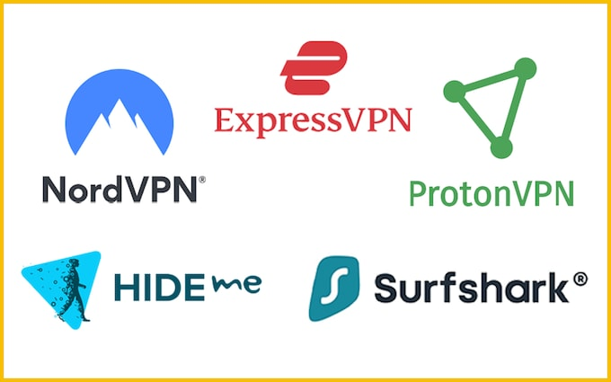
Virtual Private Networks

Slide 44
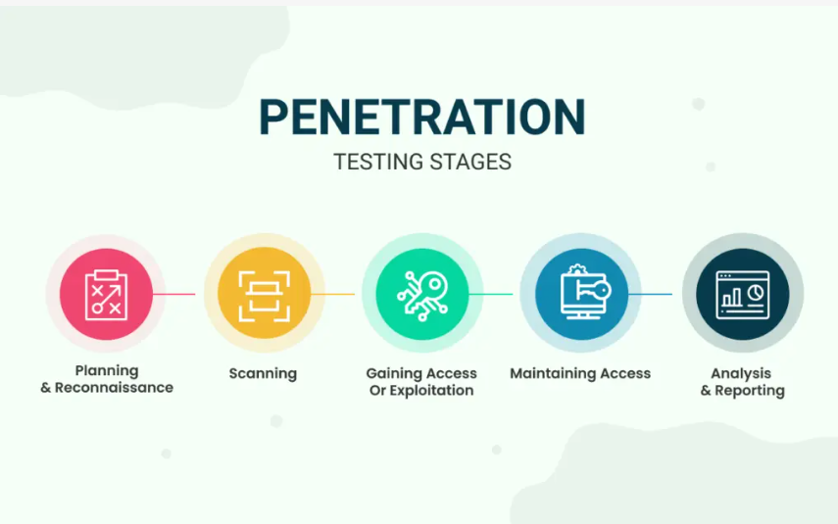
Penetration Testing your system

Slide 45
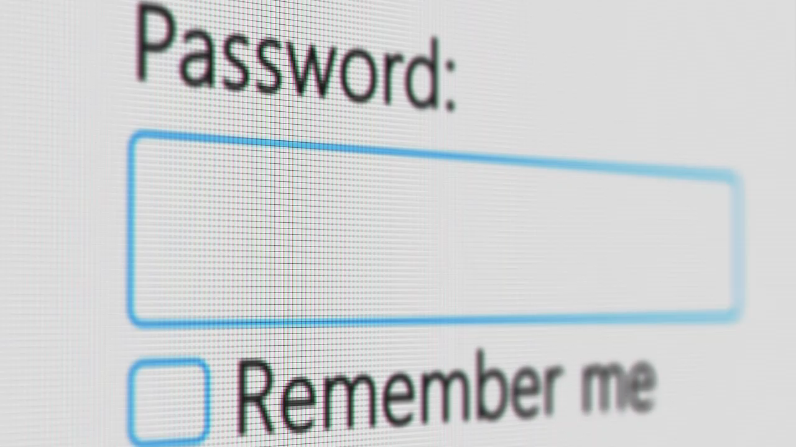
Cyber Security Training

Slide 46
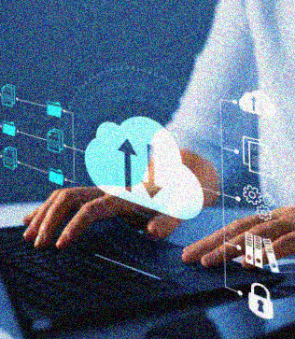
Strong access control
Implement strong access control measures to ensure that only authorized users can access cloud resources. This can include multi-factor authentication, strong password policies, and role-based access controls.

Slide 47

Encryption
Encrypt data both at rest and in transit to prevent unauthorized access. This can include using SSL/TLS for web traffic, encrypting data stored in the cloud, and using encryption keys that are managed by the customer.

Slide 48
Regular backups and disaster recovery
Regularly backup data and test disaster recovery plans to ensure that data can be recovered in the event of an attack or other disaster.

Slide 49

Regular updates and patching
Regularly update and patch all software, applications, and operating systems to ensure that they are protected against known vulnerabilities and exploits.

Slide 50
Network security
Implement network security measures such as firewalls, intrusion detection and prevention systems, and security monitoring to detect and prevent cyber attacks.

Slide 51
Employee training
Train employees on security best practices and how to recognize and respond to cyber threats. This can include regular security awareness training, phishing simulations, and incident response training.

Slide 52
Bibliography
Cyber-Attacks in Cloud Computing: A Case Study Jitendra Singh Department of Computer Science, PGDAV College, University of Delhi
https://www.arcserve.com/blog/7-most-infamous-cloud-security-breaches
https://www.npr.org/2021/04/09/986005820/after-data-breach-exposes-530-million-facebook-says-it-will-not-notify-users
https://www.npr.org/2019/07/24/741282397/facebook-to-pay-5-billion-to-settle-ftc-privacy-case
https://openai.com/blog/chatgpt

Slide 53

Thank You for Listening!

